Slide 1
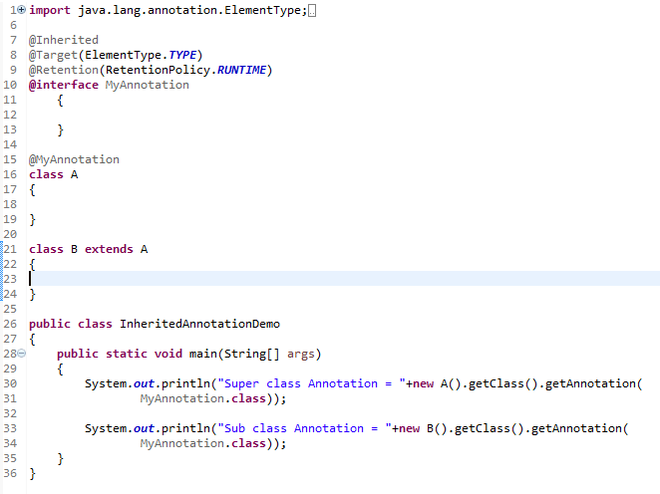
@Inherited Annotation
This is how we can specify @Inherited annotation.
By default, annotations are not inherited to subclasses.
The @Inherited annotation marks the annotation to be inherited to subclasses.
@Inherited annotation means that subclasses of annotated classes are considered having the same annotation as their superclass

